Slide 1
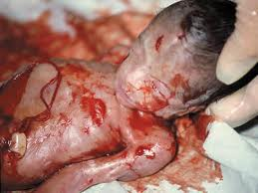
Should Abortion be Legal?
By Maria Molina
Period 6

Slide 2
Aim: Should Abortion be Legal ? Do now: Giving reasons if abortion should be legal

Slide 3
Abortion
American women have the legal right to obtain an abortion in all 50 states, through all nine months of pregnancy, for virtually any reason at all. This has been true since the Supreme Court declared that autonomous abortion rights are built into the Constitution, and that any legal barriers which prevent mothers from aborting their children are unconstitutional. This ruling was arrived at on the premise that the 9th and 14th Amendments, according to legal precedent established during the 1960's, guarantees a woman's "right to privacy," a right that extends even to abortion. In this case women who are the one to abort are women who has been raped by someone or been raped by a family member also most women know young girls don’t think when their having sex they don’t use protection and when they get pregnant, if they live in a home with parents that wont support them or their afraid to tell their parents cannot get help from anywhere else where or go to get help at the family planning. They have to consider if what their going to do is the right choice. When it comes to a choice, it’s one of the biggest steps your going to choose your whole life.

Slide 4
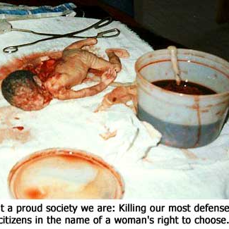
Current Status of My issue
Why is abortion such a big deal ?
Abortion is a big deal because when it comes to a baby being in the mothers belly for 20 weeks reacts physically to outside stimuli such as sound, light and touch. The sense of touch is so acute that even a single human hair drawn across an unborn baby's palm causes the baby to make a fist Surgeons entering the womb to perform corrective procedures on tiny unborn babies have seen those babies flinch, jerk and recoil from sharp objects and incisions. Babies of 5 months actually feel pain more intensely than adults. First Salt water is injected into the womb through the mother’s abdomen. The unborn baby swallows this fluid, is poisoned and dies in a process that sometimes takes 24 hours. The toxic saline solution causes severe burns over the unborn child’s entire body. Then the baby is delivered by the feet first except for the head which is later on is crushed at the base of the skull with a sharp object, then the brain is later on sucked out and finishes killing the baby.

Slide 5
Abortion!
Pro Argument
Con argument
A fetus is nothing more than a cellular growth, akin to a parasitic tumor, for which the mother is an incubator. The fact that it is comprised of living cells is essentially moot in regards to the morality of the matter -- the entire Earth is alive, but do we get charged with mass murder every time we walk across the grass? Of course not. Were one to view this issue from a "primal" point of view, abortion is technically an act of natural selection. Humans are not the only ones to rid themselves of offspring. Abortion should be legal, women who get raped especially by a family member has high possibilities to come out unhealthy or disable. Also Besides for a fact that women shouldn't be told by the government that they can't have that right, it is dangerous to make it illegal. As with anything that is illegal(drugs, for example) people will still find ways to do it. A back alley abortion is dangerous. However, I don't think it should be used as a form of birth control. You have to think it through.
Abortion Shouldn’t be legal because in many ways the little innocent life she’s carrying has no fault of anything not even if she got raped. Abortion is most definitely wrong because of the inherent humanness of the embryo. Yes, a fetus is small. Yes, it is unintelligent and incapable, but it's still human-- let's look at what we eat. A chicken is undoubtedly more intelligent than a newborn, as is a turkey, a cow, and without the slightest doubt a pig. But we don't eat newborns, and we eat these. Because the newborn is a human being. As we all have heard babies can feel when their getting aborted and feel more pain then what the mother feels. If she don’t want to raise the child, there are other choices instead of aborting if she don’t want to be the one raising the kid for an example she can give the baby in adoption it wont be easy but you’ll have a great comfort and you’ll know your child lives and is getting the love you couldn’t give him/her.

Slide 6
Court Cases
Griswold v. Connecticut, 1965
- Griswold violated the Fourteenth Amendment
Eisenstadt v. Baird 1972
-the Court ruled 6-1 in favor of Baird, finding that the law violated the Equal Protection Clause of the Fourteenth Amendment
Roe v. Wade case 1973
- Texas law violated the due process clause of the 14th Amendment

Slide 7
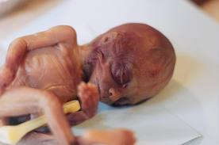

Slide 8
