Slide 1
Sputnik: The Russian Threat
By Shahrouk Reza
Period 3

Slide 2
What was Sputnik?
The World’s first man-made satellite (that actually made it to space)
Launched before planned White House launch of “Vanguard”, the US’s first satellite (4th October, 1957)
Soviet technological achievement took the world by surprise
Transition from the Arms Race to The Space Race

Slide 3
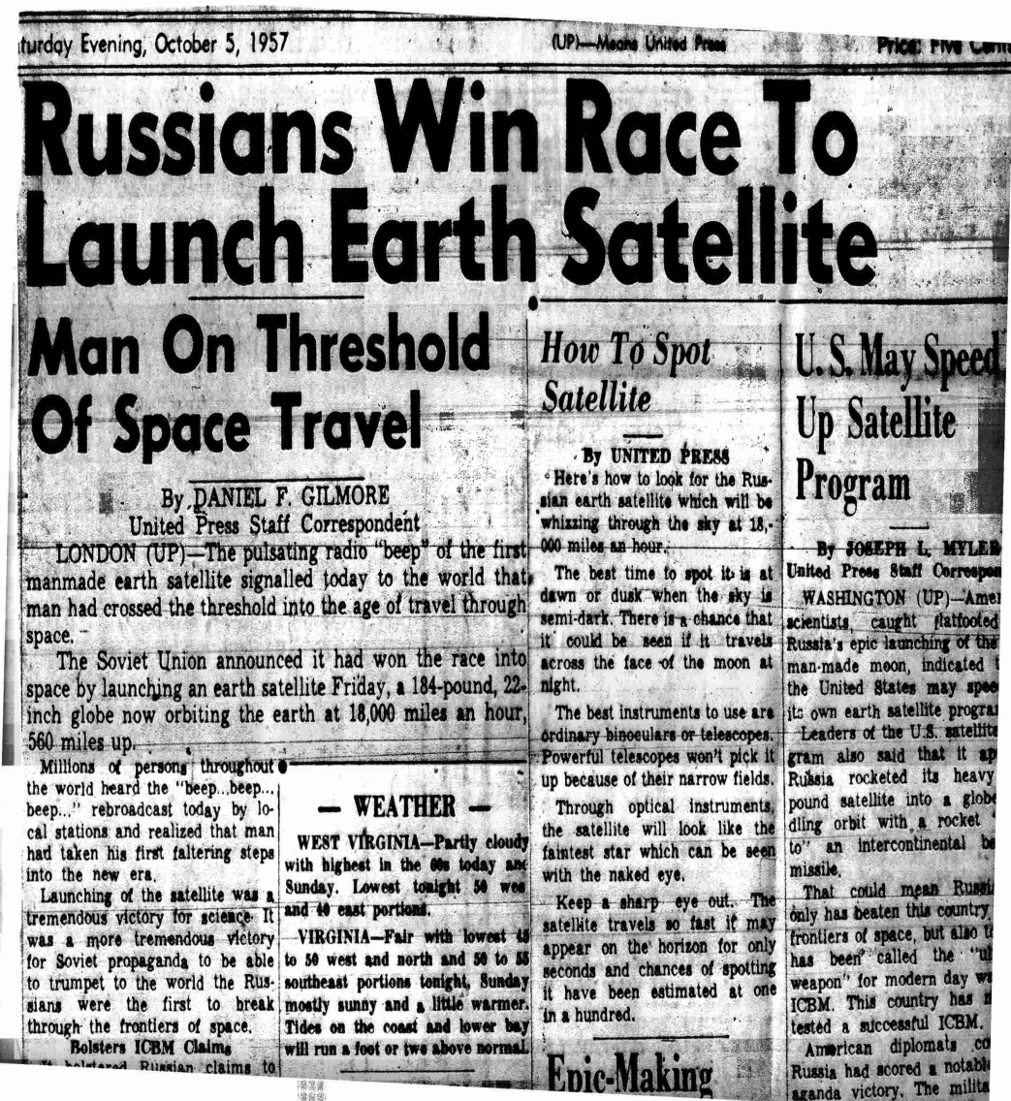
The Craft Itself
Ball-Shaped Container
Two halves, each two millimeters thick and connected by 36 bolts
Total diameter of 580 mm (22 inches)
Weighed 83.6 kg

Slide 4
The Cold War and Technological Superiority
Started after WWII
Democracy vs. Communism United States vs. Soviet Union
A climate of fear permeated the United States, especially in regards to increasing Soviet power and the spread of communism
A nuclear arms race fueled by the bombings of Hiroshima and Nagasaki

Slide 5
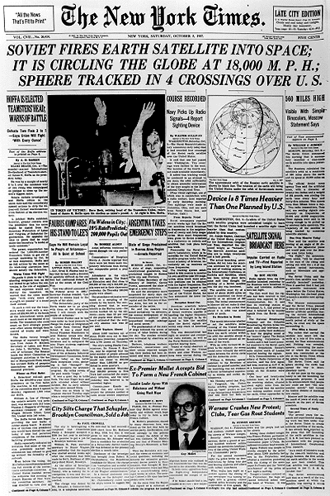
The Spark of The Space Race
The Sputnik Crisis
Before Sputnik, progress in aerospace development was relatively slow
At the time, the US was in the earliest stages of “Vanguard”
The Soviet launch of Sputnik, which was bigger and more advanced than Vanguard, shocked the US into accelerating its pace
There was also the fear that the Soviets would use Sputnik for surveillance and military uses and the US would be unable to retaliate

Slide 6
Are They Smarter Than Us?
The Education Crisis
The Sputnik launch alerted the US Government to a crisis in American education
Increased need for scientific education led to focus on science and engineering in education
Caused the passage of the National Defense Education Act of 1958 - $1 billion

Slide 7
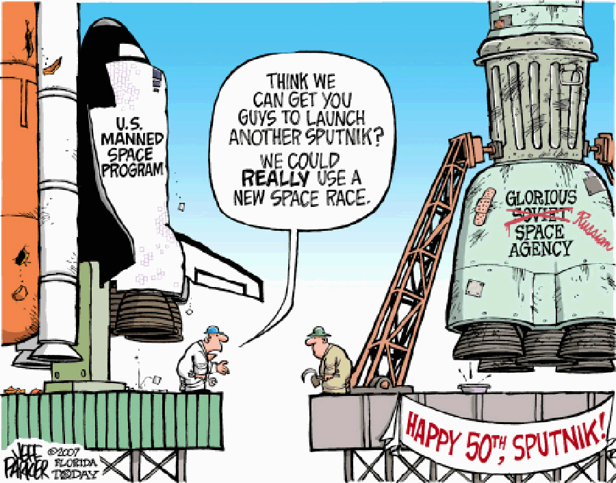
Effects on the American Society
Greatly increased interest in science and technology among the general population
Sputnik could be “heard” by amateur radio operators
There was a “crisis of confidence (PBS)” , especially in American technological innovation
Public interest and support greatly increased the pace of scientific research in the US, particularly in engineering

Slide 8
New Agencies Emerge
Sputnik, travelling at a speed of 18,000 mph, rounded the globe several times
The US was fearful of the spying capabilities this gave the USSR
Led to the creation of Advanced Research Projects Agency (ARPA) in 1958, to regain lead in the tech race and be prepared in case of Soviet Attack (Evolved into DARPA)
President Eisenhower also signed the National Aeronautics and Space Act, thereby bringing current-day NASA into existence

Slide 9
NASA and the American Space Program
National Aeronautics and Space Administration
American Space Agency
Signed into existence by Eisenhower in 1958
Civilian agency
In charge of all American space missions, manned or unmanned, including the Apollo missions, which succeeded in landing a man on the moon on July 20th, 1969

Slide 10
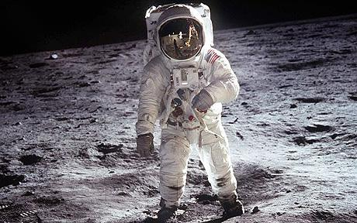
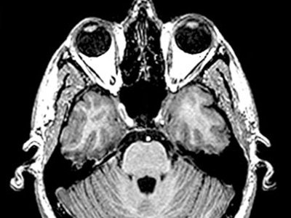
Consequences as Seen Today
Renewed importance of science and engineering in education and sparked the Space Race
Principal motivator for the technological innovations that came about as a result of the Space Race, as well as for humankind going to another world
DARPA eventually developed the first backbone for the modern day Internet (ARPANET)
Averted nuclear war by diverting tensions into another competitive arena

Slide 11
Bibliography
"Sputnik and The Dawn of the Space Age." NASA. N.p., n.d. Web. 29 May 2013. <http://history.nasa.gov/sputnik/>.
"Sputnik." Cold War Museum. N.p., n.d. Web. 29 May 2013. <http://www.coldwar.org/articles/50s/sputnik.asp>.
Abramson, Larry. "Sputnik Left Legacy for U.S. Science Education." NPR. NPR, n.d. Web. 30 May 2013. <http://www.npr.org/templates/story/story.php?storyId=14829195>.
"Sputnik Design." Russian Space Web. N.p., n.d. Web. 30 May 2013. <http://www.russianspaceweb.com/sputnik_design.html>.
Dickson, Paul. "Sputnik's Impact on America." PBS. PBS, 06 Nov. 2007. Web. 02 June 2013. <http://www.pbs.org/wgbh/nova/space/sputnik-impact-on-america.html>.

