Slide 1
Marijuana Legalization
By
Gabriel Yagual, Devindra Ramayya, Rayhanna Mohan, Omawattie Narine, Melanie Lassiter

Slide 2
Aim: Why does our society think or not think marijuana should be legalized? Do now: What are the pros and cons of the legalization of marijuana?

Slide 3
Pros and cons of marijuana:
Pros:
Can relieve pains like nausea, vomiting, and other types of sicknesses like sclerosis, cancer, and aids.
It can relieve stress and stave off the effects of some illnesses, which was stated from government officials.
Can provide a temporary reprieve from reality. (effects of the “high”)

Slide 4
Pros and cons of marijuana: (Continued)
Cons:
Can be addicting and people tend to takes advantage and begin to sell and becomes an epidemic.
Minors gain possession of the drug and are abusing it.
Smoking lots of it can kill brain cells.
Another government official stated that it can damage your brain, heart, and lungs.
Collapses veins and restricts circulation.

Slide 5
United States v. OCBC and Jeffrey Jones
Case: Oakland Cannabis Buyer's Cooperative and its owner, Jeffrey Jones, distributed marijuana for medical purposes and claimed it was legal under Federal Law. The US government disagreed and sued the cooperation under the Controlled Substances Act.

Slide 6
Conant v. Walters
Case: When California passed its medical marijuana regulations in 1996 the US government threatened physicians who recommended marijuana with the loss of their license. Physicians and patients filed this class action lawsuit. The US District Court and the Court of Appeals for the Ninth Circuit found for the physicians and issued a Permanent Injunction, which permits physicians to discuss marijuana with their patients and to approve the use of marijuana in their medical treatment.

Slide 7
Gonzalez v. Raich
Two medical marijuana patients, Angel McClary Raich and Diane Monson, filed a complaint and motion for preliminary injunction against US Attorney General John Ashcroft and former DEA Administrator Asa Hutchinson.
The complaint stated that John Ashcroft and Asa Hutchinson are "unconstitutionally exceeding their authority by embarking on a campaign of seizing or forfeiting privately-grown intrastate medical cannabis from California patients and caregivers, arresting or prosecuting such patients, mounting paramilitary raids against patients and caregivers, harassing patients and caregivers, and taking other civil or administrative actions against them." clinics or clubs that "sell" medical marijuana (and are not patient co-ops), will be more vulnerable to federal arrest and seizure. The US Drug Enforcement Administration and other law enforcement agencies may feel bolstered by the decision, and use it to "crack down" on medical marijuana centers, cultivations, patients, and their caregivers.

Slide 8
History Of Marijuana
1619
An old 1619 Virginia statute required farmers to grow hemp, from which cannabis can be derived. While this requirement was presumably based on hemp's non-pharmaceutical properties, this fact is understandably cited by legalization proponents as an ironic event in the history of marijuana law.

Slide 9
History Of Marijuana (Continued)
1839
The Irish physician and herbalist William Brooke O'Shaughnessy publicizes the medical benefits of cannabis, and medical marijuana becomes a useful ingredient in many pharmaceutical products over the coming decades.

Slide 10
History Of Marijuana (Continued)
1854
A New York Times column refers to marijuana as one of "our fashionable narcotics," even though marijuana is not actually a narcotic. This casual use of the term "narcotic," to refer to non-opiates that have significant recreationally-beneficial side effects, continues to this day.

Slide 11
History Of Marijuana (Continued)
1905
A pamphlet published by the U.S. Department of Agriculture identifies cannabis as a poison, substantially limiting its use in pharmaceutical cocktails.
1937
The Marijuana Tax Act prohibits the legal distribution of marijuana for non-medical purposes.

Slide 12
History Of Marijuana (Continued)
1951
The Boggs Act establishes mandatory minimum sentences for the distribution of marijuana
1969
As part of his antidrug policy, President Richard Nixon implemented Operation Intercept - which imposed strict, punitive searches of traffic along on the U.S.-Mexican border.

Slide 13
History Of Marijuana (Continued)
1996
California voters passed Proposition 215, which legalized medical marijuana throughout the state. Since 1996, 15 other states and the District of Columbia have also chosen to make possession of small amounts of marijuana, for medical purposes, legal. The federal government has not cooperated with these laws, resulting in federal raids on medical marijuana dispensaries that act in accordance with state law.
2005
In Gonzales v. Raich, the U.S. Supreme Court held that the federal government may continue to enforce anti-marijuana laws, even against citizens who act in accord with state-level medical marijuana regulations.

Slide 14
History Of Marijuana (Continued)
2011
NYPD police Chief Ray Kelly issued a memo calling on officers to deprioritize misdemeanor marijuana arrests, which had previously consumed massive police resources and led to racial profiling practices. This is consistent with municipal laws in Oakland, San Francisco, and Seattle which classify marijuana possession as the "lowest law enforcement priority," the closest a city government can likely come to unilaterally legalizing marijuana possession without operating in violation of state law.

Slide 15
Current Status
New Jersey Protects "patients who use marijuana to alleviate suffering from debilitating medical conditions, as well as their physicians, primary caregivers, and those who are authorized to produce marijuana for medical purposes" from "arrest, prosecution, property forfeiture, and criminal and other penalties." Also provides for the creation of alternative treatment centers, "at least two each in the northern, central, and southern regions of the state. The first two centers issued a permit in each region shall be nonprofit entities, and centers subsequently issued permits may be nonprofit or for-profit entities."

Slide 16
Current Status (Continued)
Massachusetts
"The citizens of Massachusetts intend that there should be no punishment under state law for qualifying patients, physicians and health care professionals, personal caregivers for patients, or medical marijuana treatment center agents for the medical use of marijuana. In the first year after the effective date, the Department shall issue registrations for up to thirty-five non-profit medical marijuana treatment centers, provided that at least one treatment center shall be located in each county, and not more than five shall be located in any one county.“
Possession/Cultivation: Patients may possess "no more marijuana than is necessary for the patient's personal, medical use, not exceeding the amount necessary for a sixty-day supply... Within 120 days of the effective date of this law, the department shall issue regulations defining the quantity of marijuana that could reasonably be presumed to be a sixty-day supply for qualifying patients, based on the best available evidence."

Slide 17
Current Status (Continued)
New York
In recent years, the “public use” exception to New York’s 1977 decriminalization law has been abused by police officers. New York City police have asked innumerable amounts of people, mostly young people of color, to empty their pockets — this makes them criminals due to the loophole. On June 4, Gov. Andrew Cuomo expressed his support for getting rid of the loophole. Mayor Michael Bloomberg, NYC Police Commissioner Ray Kelly, and several district attorneys also support this action. Meanwhile, a sitting judge described how medical marijuana alleviates the effects of his cancer treatments, and on June 13, the Assembly passed medical marijuana legislation for the third time.

Slide 18
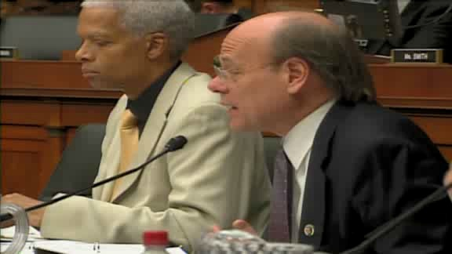
FBI Boss against marijuana legalization

Slide 19
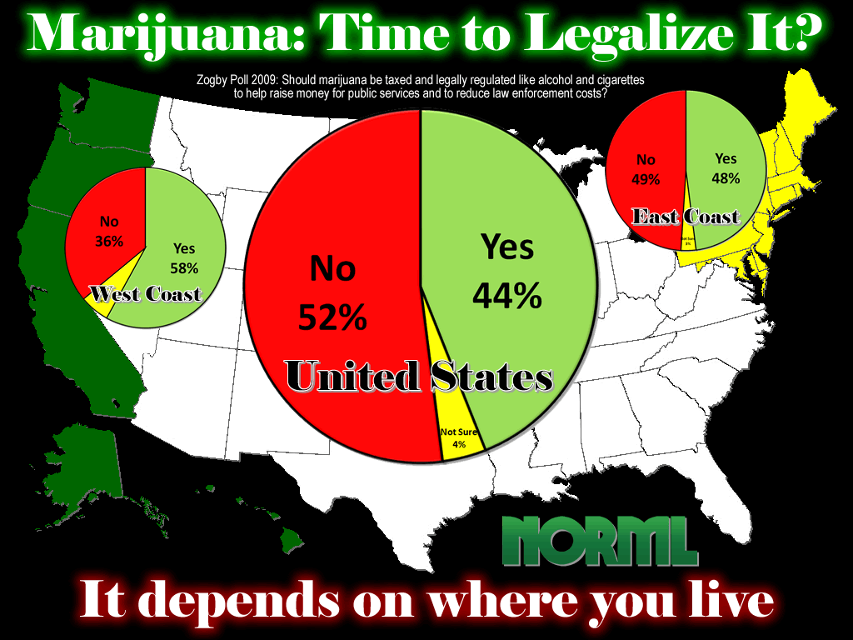
Notes:
In the Zogby Poll 2009 asked the public, Should marijuana be taxed and legally regulated like alcohol and cigarettes to help raise money for public services and to reduce law enforcement costs?

Slide 20
Summarizing- This Picture
Notes:
Summarizing this picture, the overall results in the United States are 52% saying “No”, 44% saying “Yes”, and 4% saying “not sure”.

Slide 21
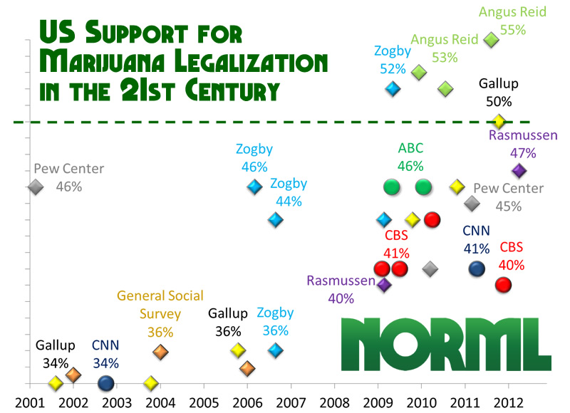
Notes:
According a recent CBS News poll conducted at the end of October, a slim majority of 51 percent continues to think that marijuana use should be illegal. But support for specifically allowing doctors to prescribe marijuana for serious medical conditions – or legalized “medical” marijuana – is far stronger: 77 percent Americans think it should be allowed.
CBS’s poll compares well to the bulk of polls on the issue over the past two years, which have ranged from 40% to 46% support for full-legalization. It’s interesting to note that no news organization has ever shown a poll with majority support for full-legalization; the five polls showing 50% or greater support all come from Zogby, Angus Reid, and Gallup.

Slide 22
Notes:
As for the “harm to user and society”, POLICE readers still felt by a margin of 3-2 that alcohol was “more of a threat to the community” than marijuana.

Slide 23
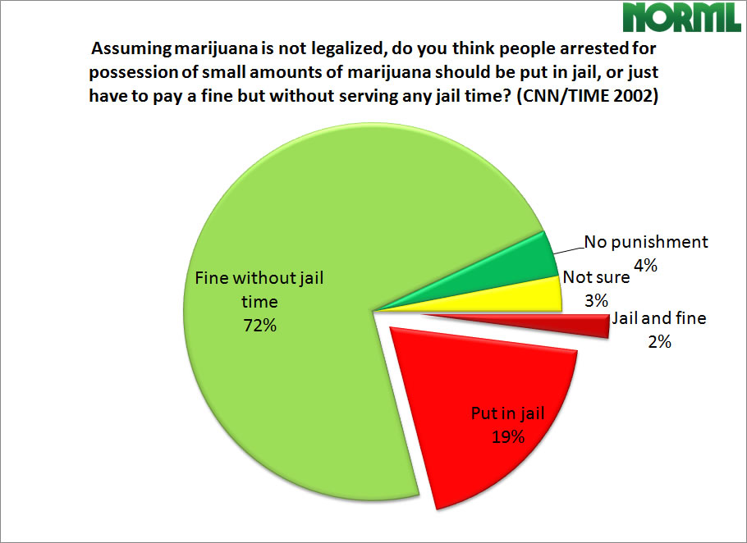
Notes:
While the general public is barely approaching majority support for outright marijuana legalization, the public has long held the belief that any punishment for adult marijuana possession should be a fine only. Three out of four Americans (76%) believe that if marijuana users are to be punished, they should only be fined and not arrested and sent to jail. Yet the POLICE Magazine survey finds that two out of three cops (65%) think it is “worth law enforcement’s time to bust marijuana users”.

Slide 24
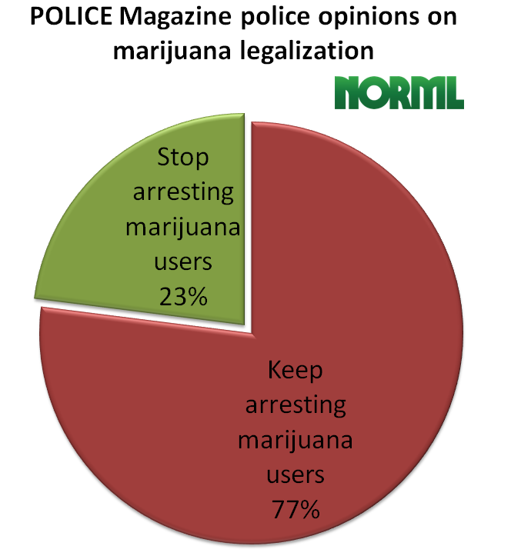
Notes:
But according to the same POLICE survey, marijuana legalization has less than half the support among cops than among the public they protect and serve. Only 23% of police supported re-legalization of cannabis

Slide 25
Jeopardy
Game
http://www.superteachertools.com/jeopardy/usergames/Oct201143/game1319808399.php

