Slide 1
Aim: How Can We Understand The 1863 NYC Draft Riots ?
Do Now: Who Were Mainly Involved In The Draft Riots?
A)African Americans
B)Irish
C)Caucasian
D) Asians

Slide 2
What Was The NYC Draft Riots ?
The Draft Riot happened on July 13, 1863, lasted three days
It was the nation first draft enabled by congress and ordered by the Lincoln administration
The Enrollment Act led to the Draft Riots
Officers had a 1,500 men quota to be filled because of the decreased ranks of men on the battlefield, the men to be drafted did not want to go to war
Only the wealthy were able to escape the draft by paying $300
Marshalls went looking for eligible men in factories and homes ages 20-45

Slide 3
What Was The NYC Draft Riots ?
Leading up to the riots thousands filled third avenue
Mostly Irish came out to protest because they composed 25% of the city's population
Men as well as women and children came armed with paving stones, bricks and iron pipes
It was a few officers against a mob of angry people
At 10:30 am a shot was fired in the air, causing the mob to attack
They stormed the Ninth District Provost Marshall's Office destroying everything in sight even burning the building and attacking Police superintendent John Kennedy nearly killing him

Slide 4
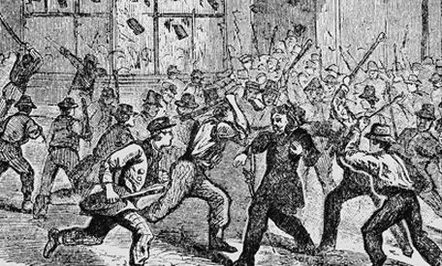
The Riot
Pictured is the mob
surrounding
Henry O’Brien before
his murder. He was the
Colonel of the 11th
New York Volunteer
Infantry Regiment .

Slide 5
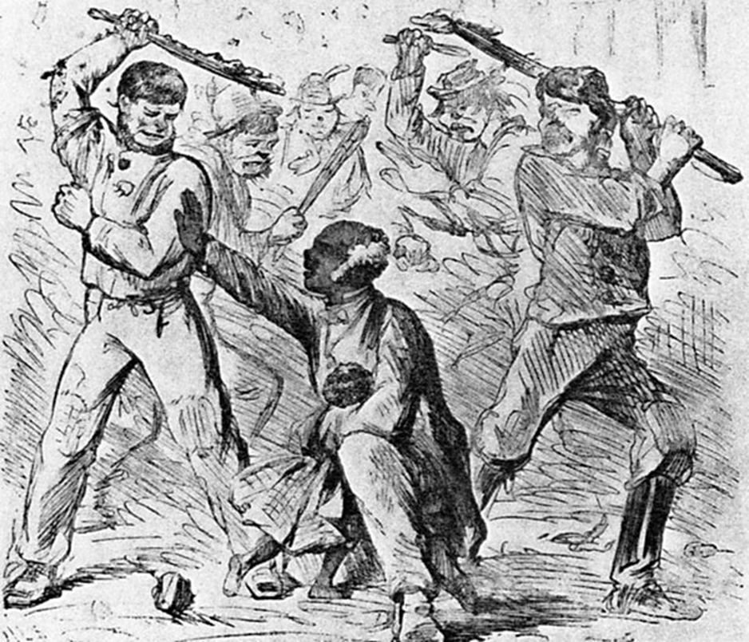

Slide 6
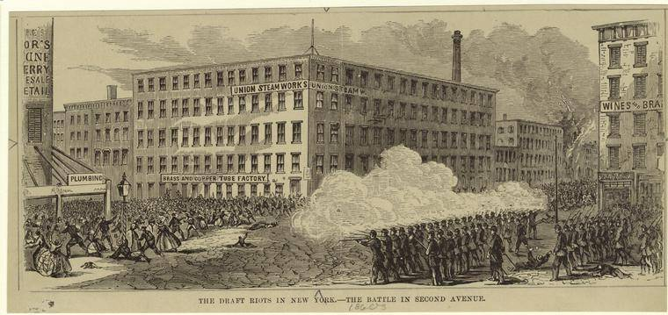

Slide 7
Social Impact
Immigrants were living better than slaves
During riots, mobs harassed and sometimes killed blacks and their supporters and destroyed their property
Citizenship was offered if you fought for your new country
Irish immigrants took their anger out on African American because they were being force to fight for them
The number of people killed were 2,000 and 8,000 the riots lasted for three days

Slide 8
Political Impact
The states secession was more impacted on the entire political
The union and the confederate were fighting the civil war
The Emancipation Proclamation proposed to free all slaves that were in the rebelling slave states but it never happened

Slide 9
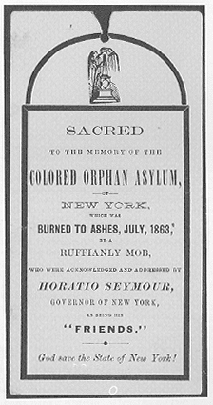
Economic & Cultural Impact
The wealthy were able to escape the draft by paying $300
Many factory workers didn’t go in to work
They were Irish thugs who would beat and lynch African American
Burned colored orphans
White male took advantage of this by
taking revenge on black workers such
as sailors, factory workers, and
dock workers

Slide 10
Background Information
http://www.newsinhistory.com/feature/new-york-draft-riots
The New York City Draft Riots: Their Significance for American Society and Politics in the Age of the Civil War by Iver Bernstein
http://www.history.com/topics/draft-riots

Slide 11
Bibliography
http://www.examiner.com/article/social-impact-of-the-new-york-draft-riots
http://www.press.uchicago.edu/Misc/Chicago/317749.html
http://articles.washingtonpost.com/2013-04-29/lifestyle/38892745_1_draft-issue-draft-controversy-marshals

