Slide 1
Aim: How can we better understand the cultural, social, and economic impacts of Woodstock?
Do Now: Have you ever been to a concert? How was your experience?

Slide 2
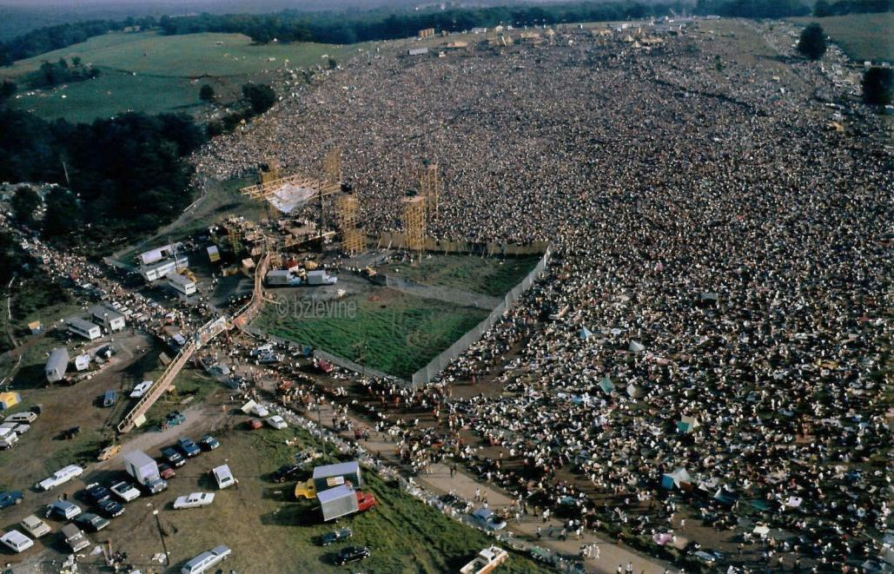
Woodstock
Woodstock took place over a course of four days (August 15-18, 1969)
Became an icon of the 1960s hippie counterculture
Located at a dairy farm, outside of White Lake, New York
Organized by John Roberts, Joel Rosenman, Artie Kornfeld, and Mike Lang

Slide 3
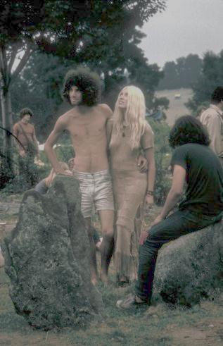
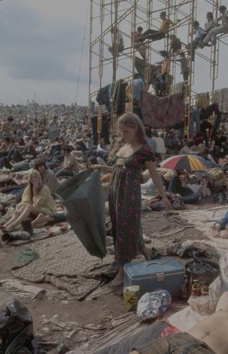
Hippie Counterculture Movement
Involved various social concerns and beliefs
They believed that the dominant mainstream culture was corrupt, and thought to replace it with a “Utopian Society”
The term Hippie came from the word Hipster, which originated from a song by Harry Gibson in 1940, “Harry the Hipster”
Hipsters were beatniks, who lived in Greenwich Village, New York
Beatniks were followers of the Beat Generation, where people expressed their beliefs through writings
They used drugs such as marijuana and LSD to explore another state of consciousness, creating their own counter culture founded on psychedelic rock and the embracement of the sexual revolution

Slide 4
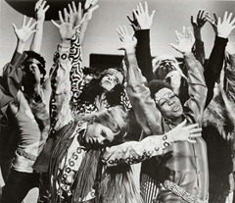
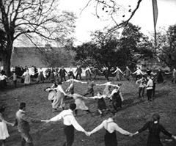
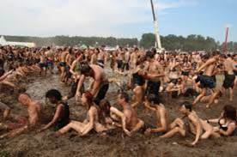
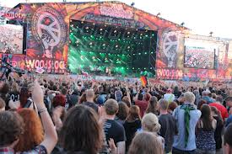
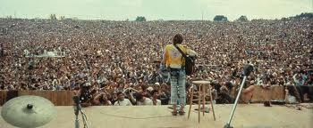

Slide 5
Purpose
Roberts was an heir of a pharmaceutical fortune, and wanted to invest his money and make more money. Creating this idea with his friend Rosenman
They made an ad in the New York Times, stating, “Young men with unlimited capital looking for interesting, legitimate investment opportunities and business propositions,” meeting Kornfeld and Lang
Lang and Kornfeld wanted to create a music studio where they can rebuild the music of rock ‘n roll
The four of them came up with the idea to throw a music festival that can make them money and pay for the costs of the studio

Slide 6
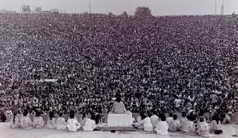
General Problems
More people attended the event than expected (500,000)
Many performers arrived by helicopter because of the enormous amount of people
There weren’t enough toilets, food, and water
Toilets took an hour wait and food and water took about the same amount of time

Slide 7
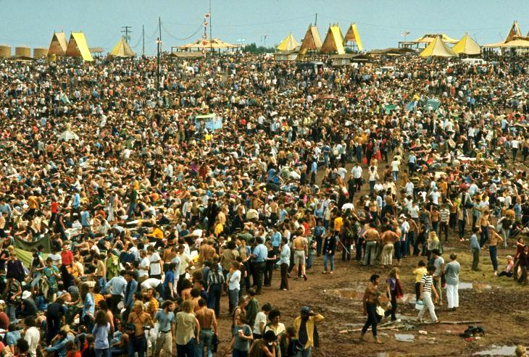

Slide 8
Location
It was originally supposed to be held in Wallkill, New York. But because of the people who lived in the neighborhood, they complained that they didn’t want drugged out teenagers parading their streets
Eventually, a law was passed by the town of Wallkill, effectively preventing the event to take place in Wallkill
Rosenman, Roberts, Kornfeld, and Lang had to find a new location to have the people and they didn’t want to refund the money back to the customers
Finally, just in time before the festival, Max Yasgur offered his dairy farm as a permanent site for the event

Slide 9
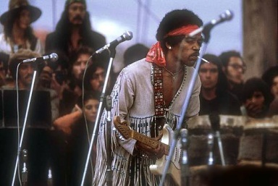
Aftermath
Woodstock was successful, despite its 70 lawsuits filed against it and $1 million debt
Luckily, the movie Woodstock covered almost nearly all of their debt, except $100,000
It was the most popular music event in history
Artists like Jimi Hendrix, Joan Baez, Santana, Sweetwater, The Who, and Grateful Dead performed at the festival making it a huge success

Slide 10
Bibliography
Video
http://www.moviesfoundonline.com/jimi_hendrix_at_woodstock.php
http://history1900s.about.com/od/1960s/p/woodstock.htm
http://life.time.com/culture/life-at-woodstock-1969/#1
Notes:
For the video, end it at around 3 minutes, so that the class gets to see the video and observe what Woodstock looked like.

